Slide 1
Rich Context Competition
New York University
With many thanks to: Schmidt Sciences, the Alfred P. Sloan Foundation, the Overdeck Family Foundation, and many other sponsors

Slide 2
Agenda

Slide 3
Goal
Find, for a given dataset, who else worked with the data, on what topics and with what results

Slide 4
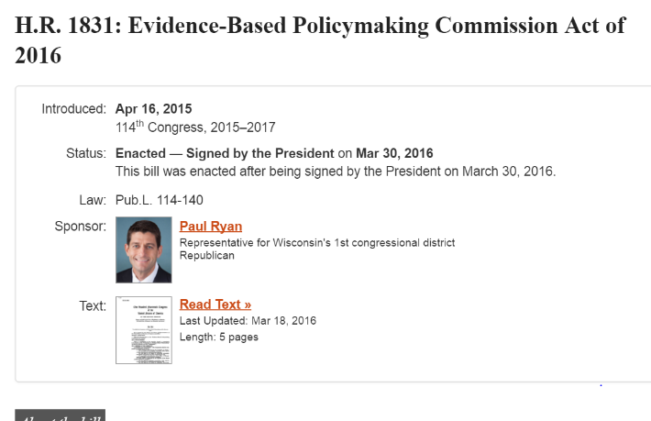
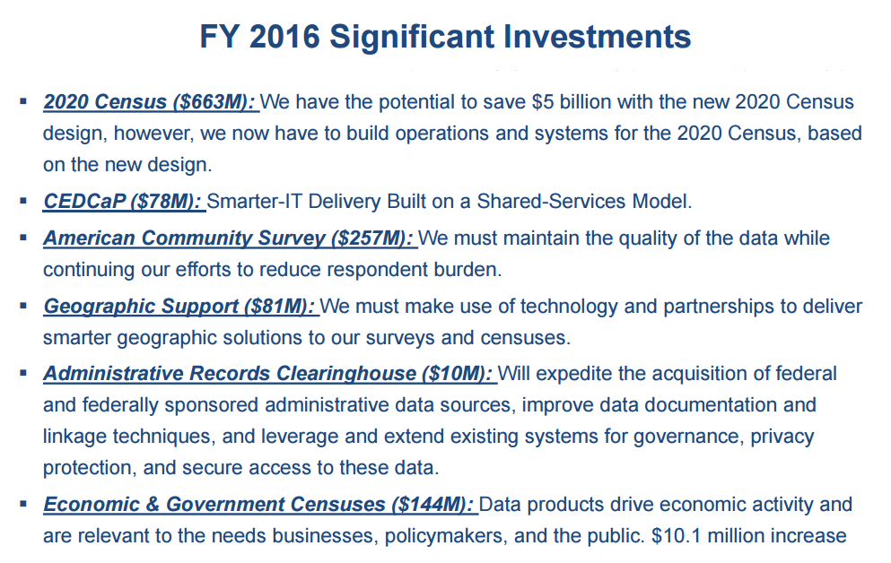
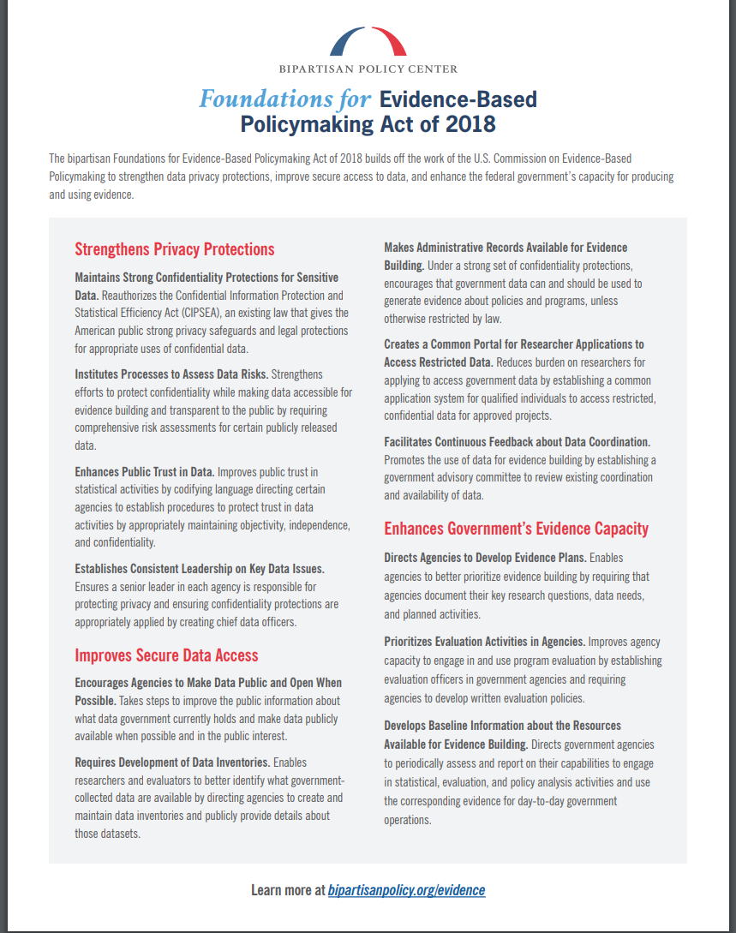
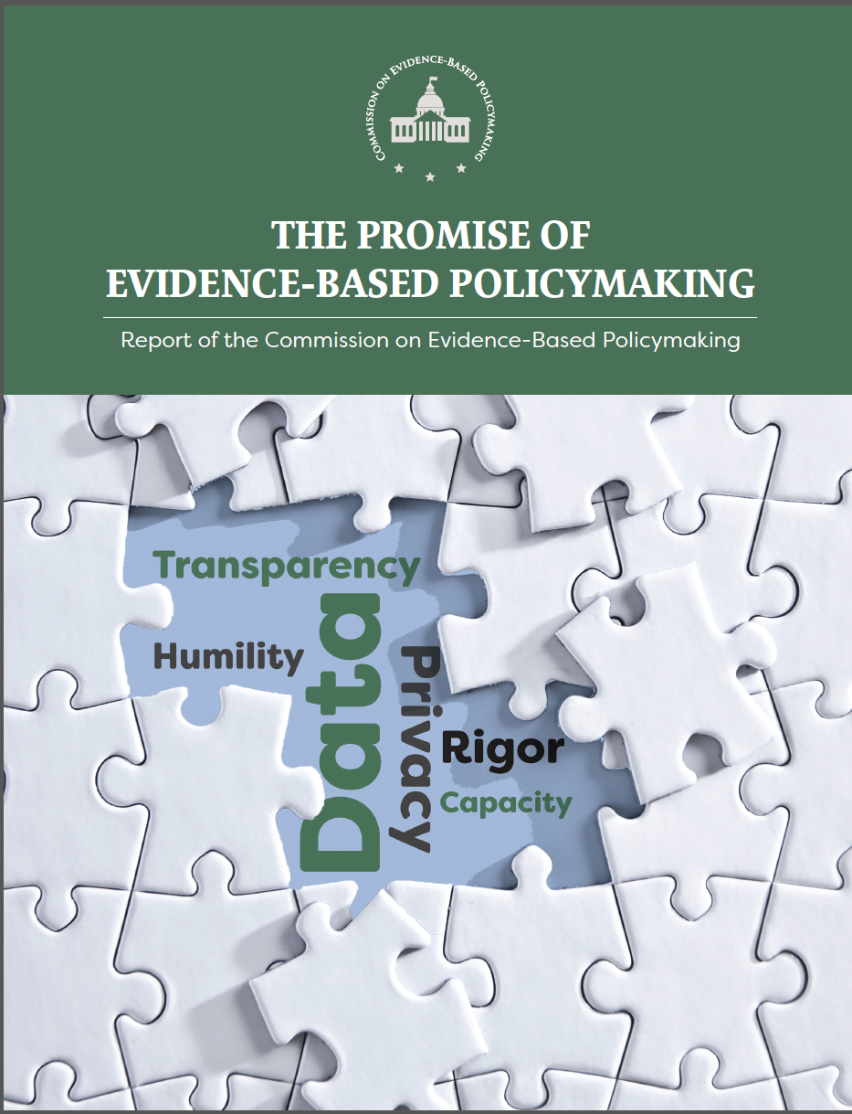
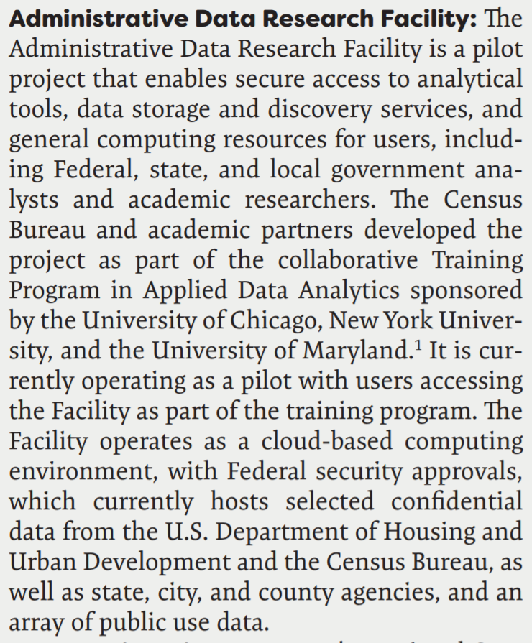
Context

Slide 5
Implementation
Technical barriers
cost
burden
data quality
Human barriers
data documentation
risk of bad analysis
legal mandates surrounding data access and use
Workforce capacity

Slide 6
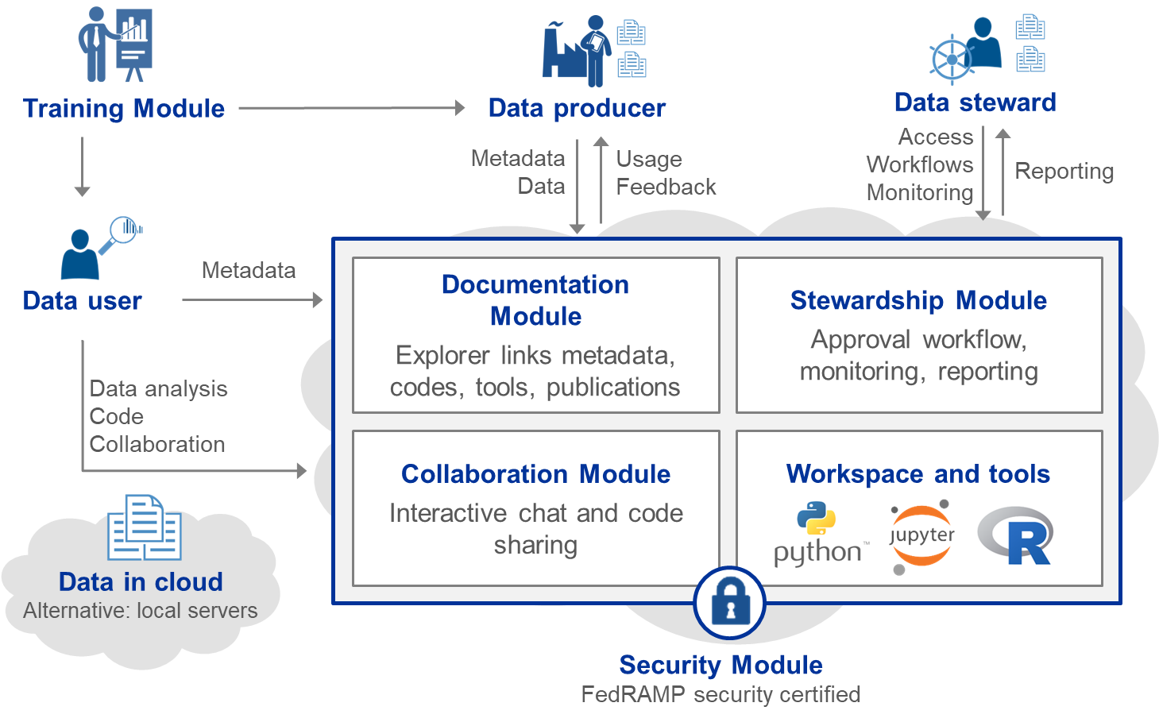
Our approach

Slide 7
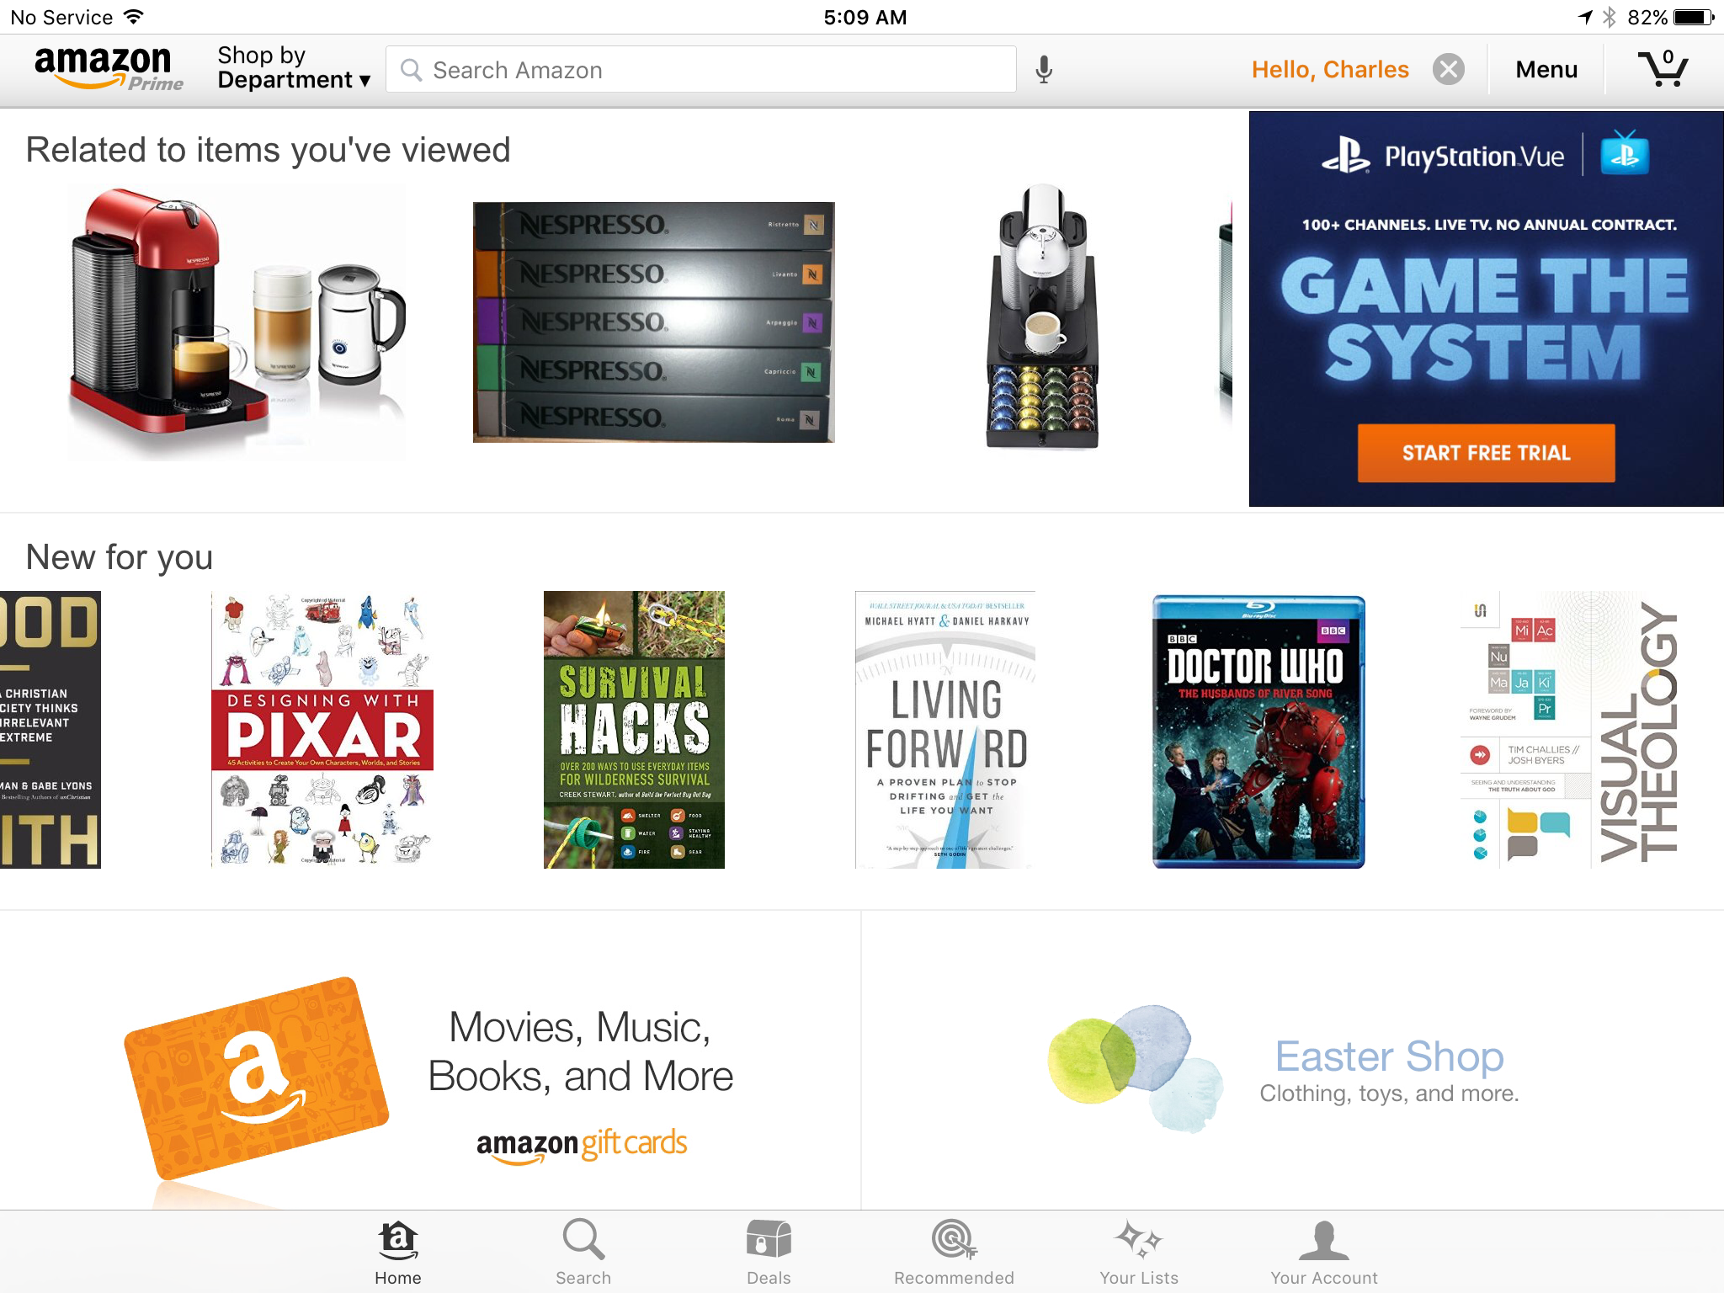
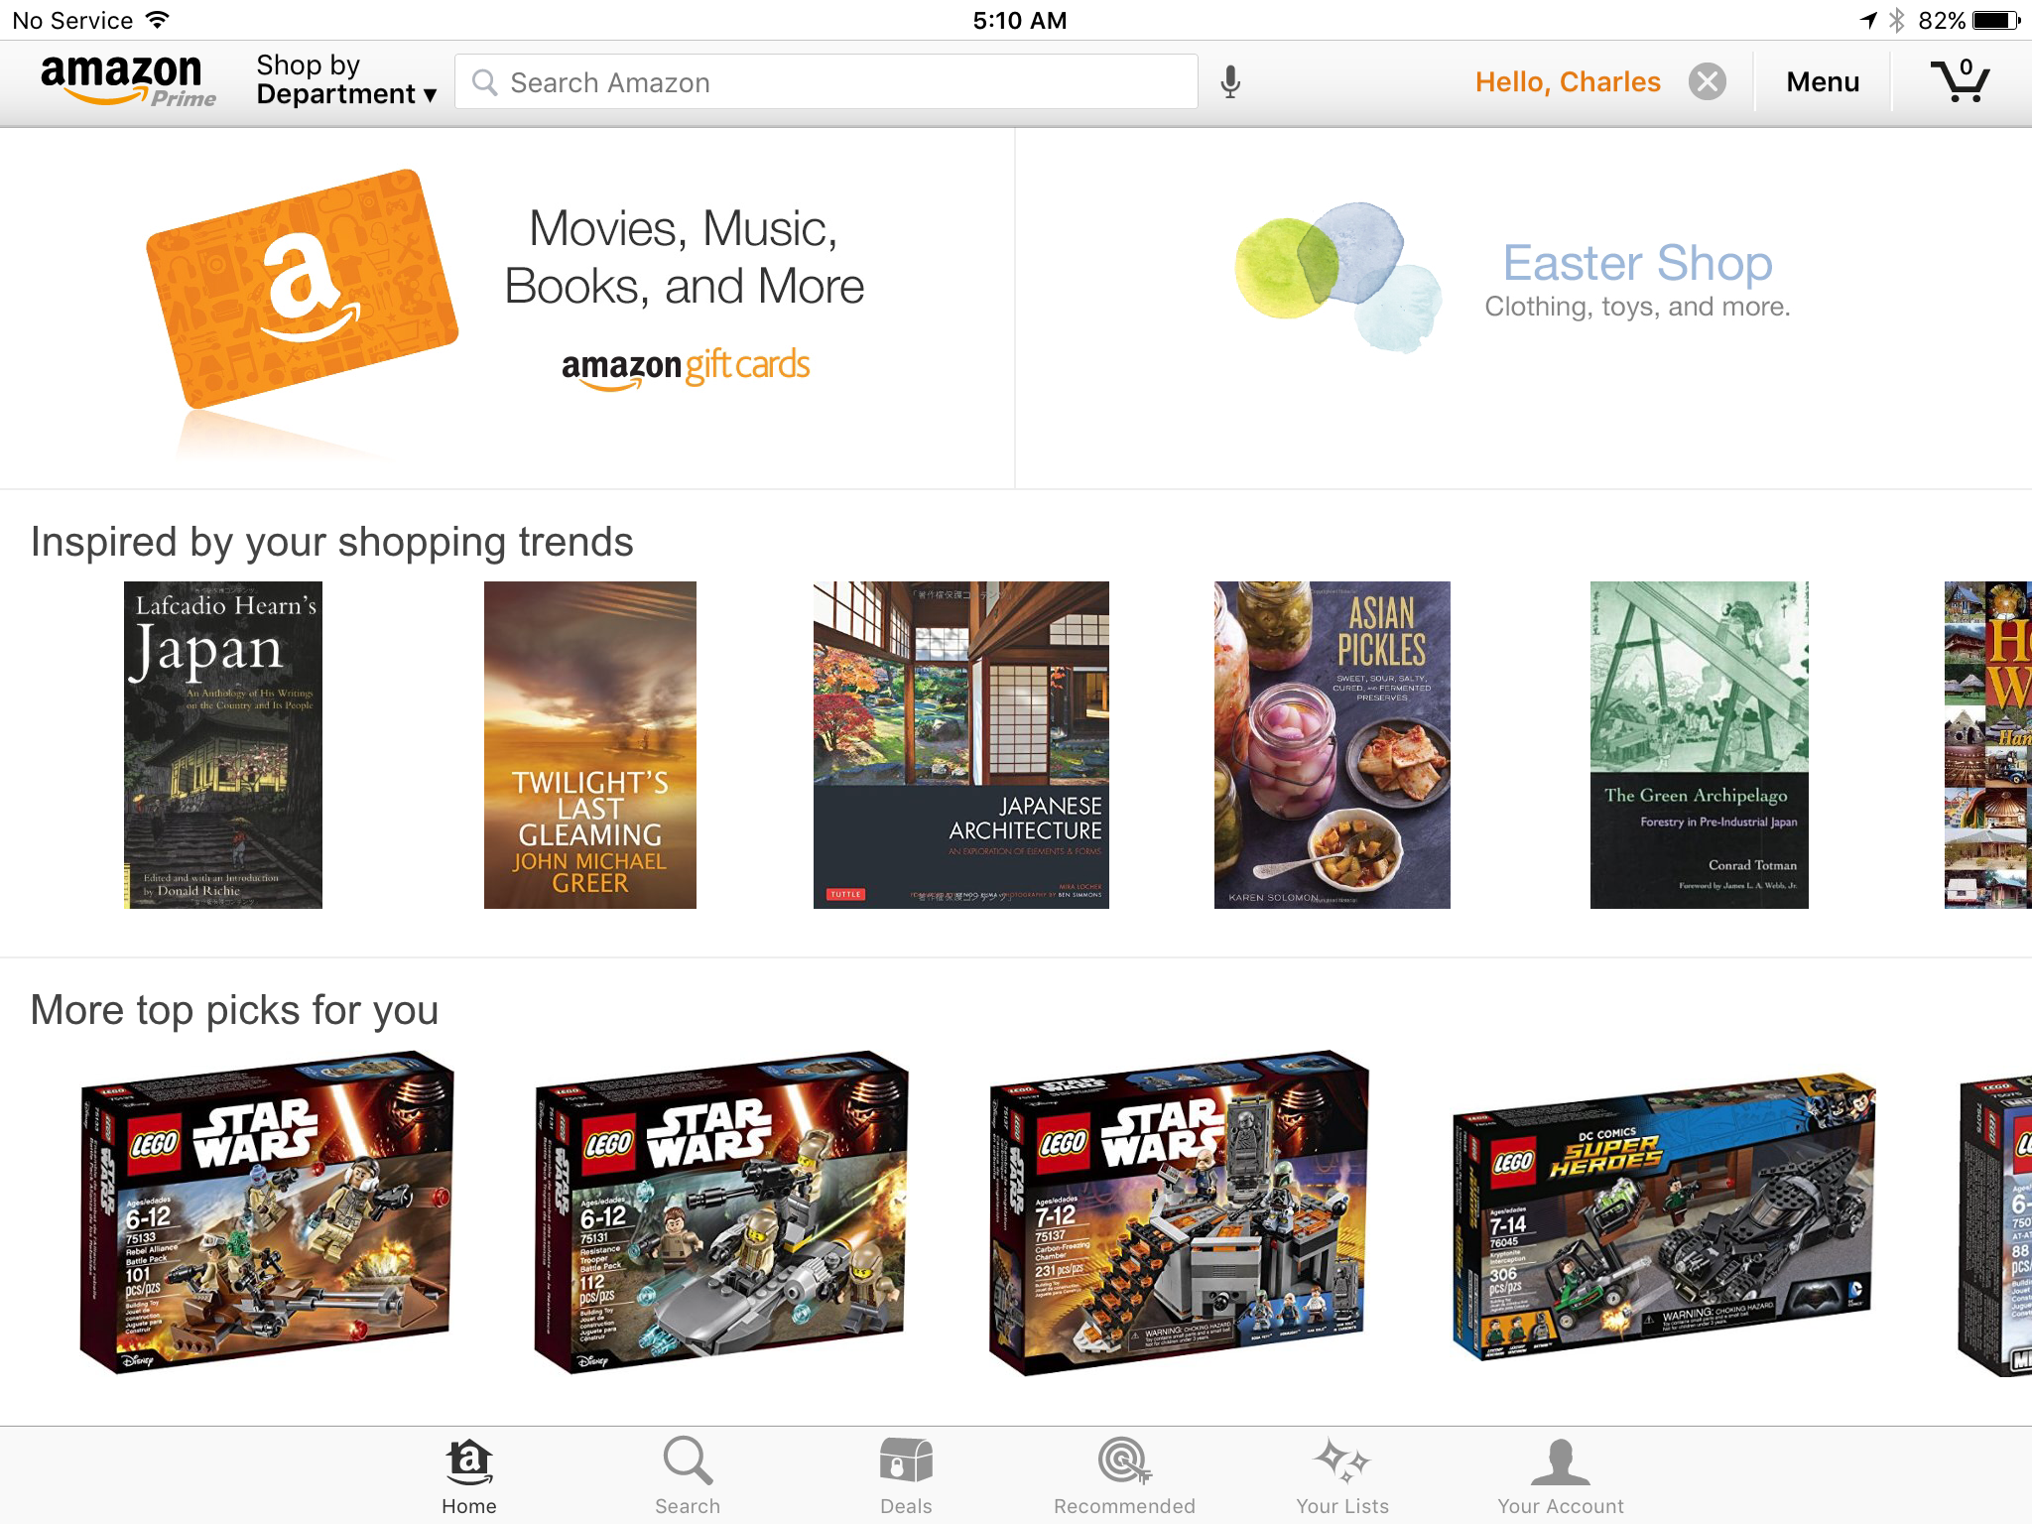
Related to data you've viewed
New data similar to data you've used
What others have done with similar data (recipes)
Recipes like yours
Thank you Charlie Catlett

Slide 8
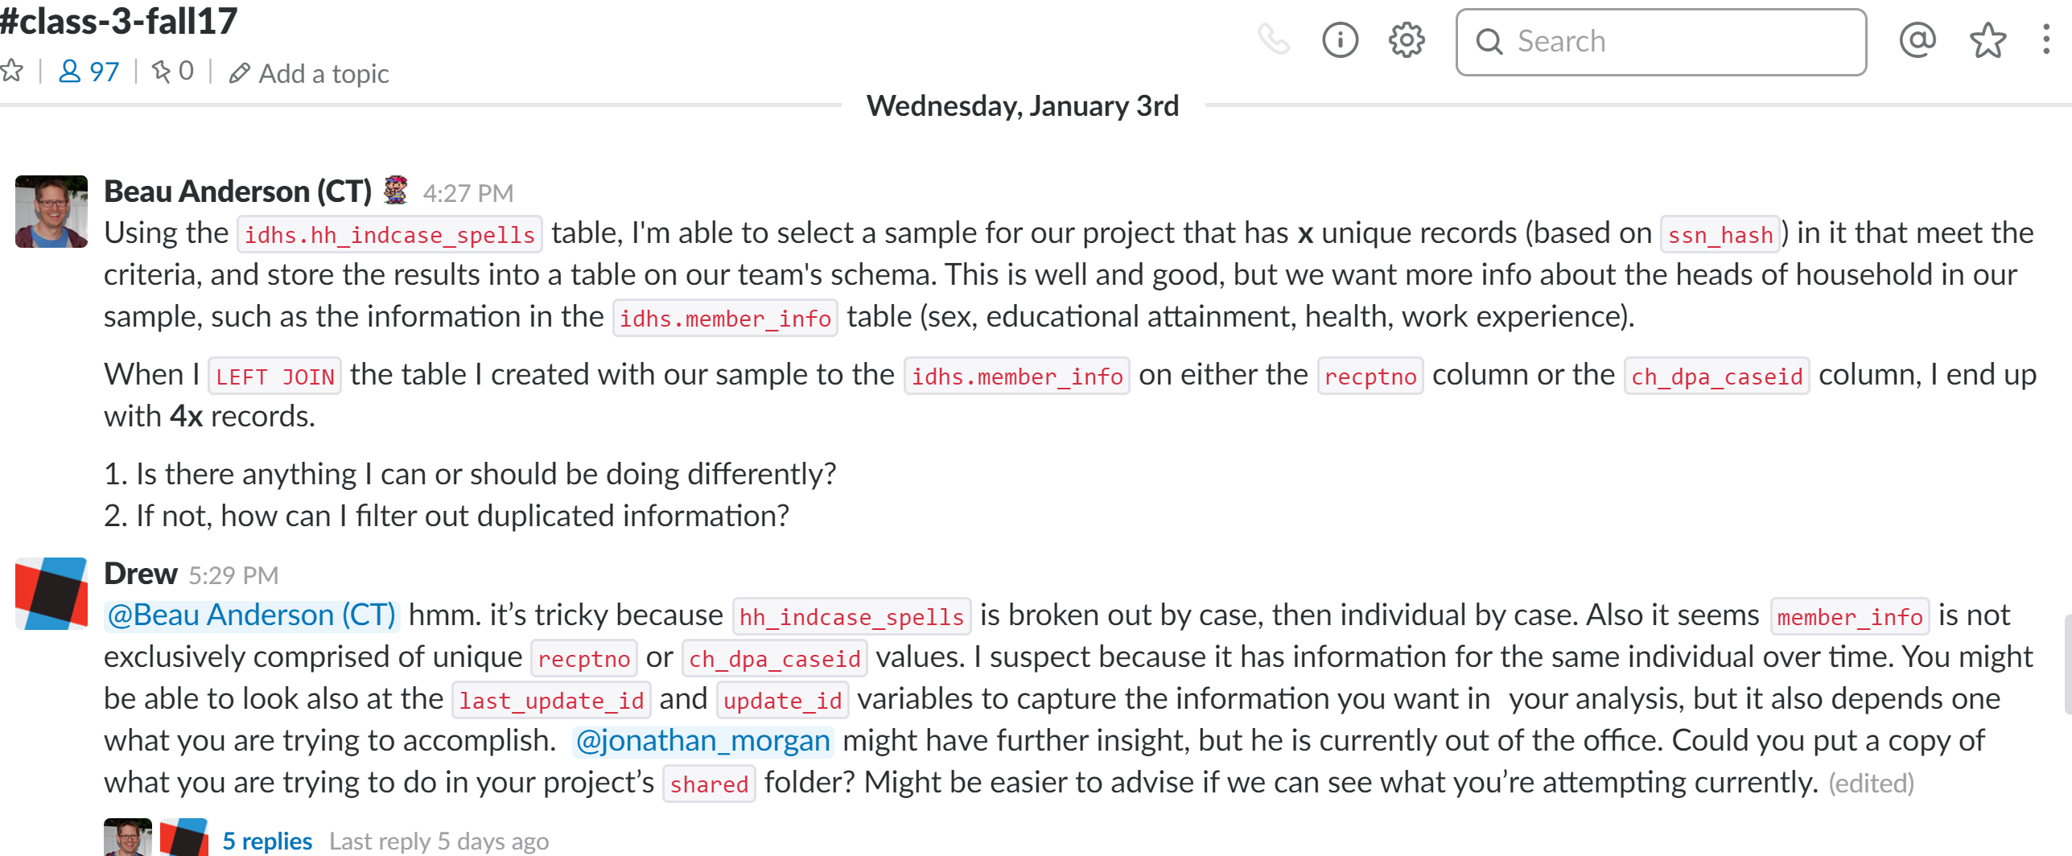
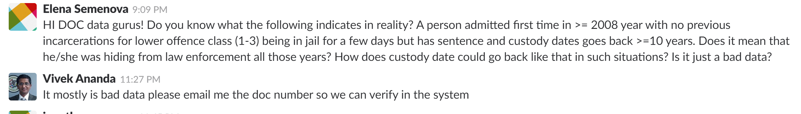
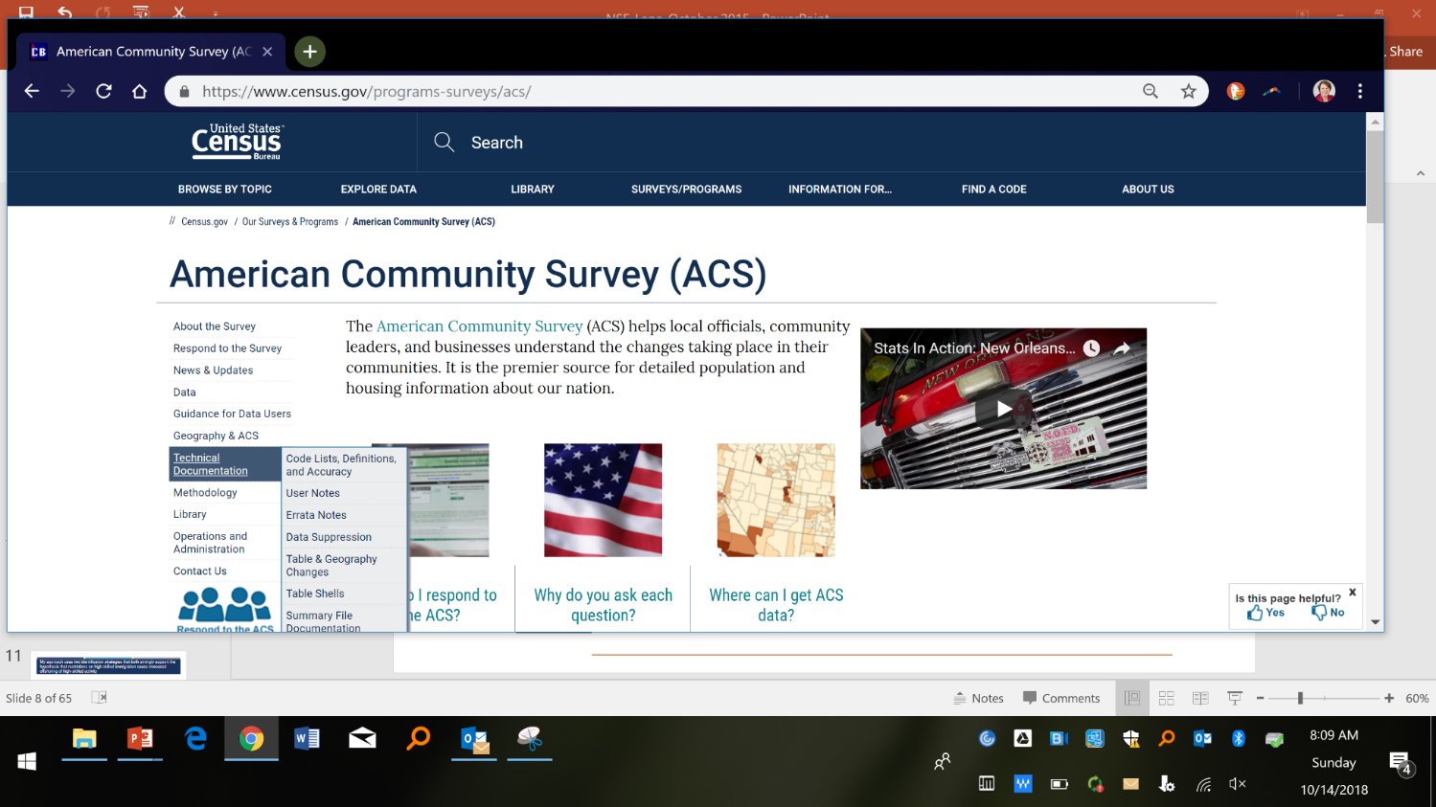
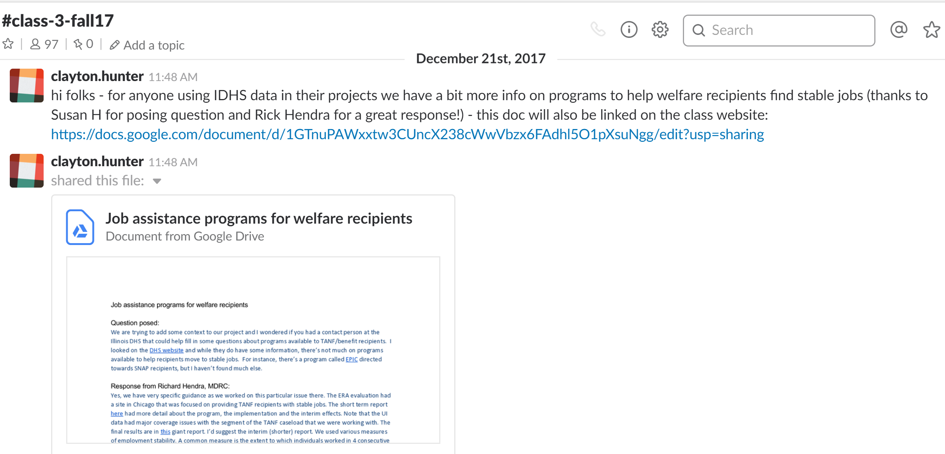
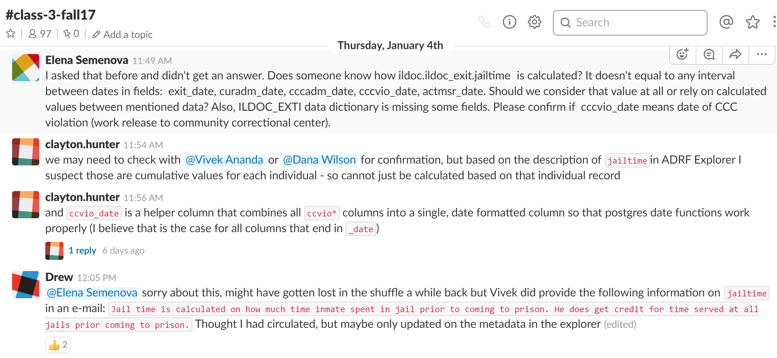
Metadata documentation

Slide 9
So how do we do this?
Step 1: Create the set of corpora and metadata (computer science technology) - Competition
Step 2; Figure out how you learn from it and automate it (machine learning techniques) - Engagement
Step 3: Gamification – recognize and emphasize patterns (with human curation) – Rinse and repeat

Slide 10
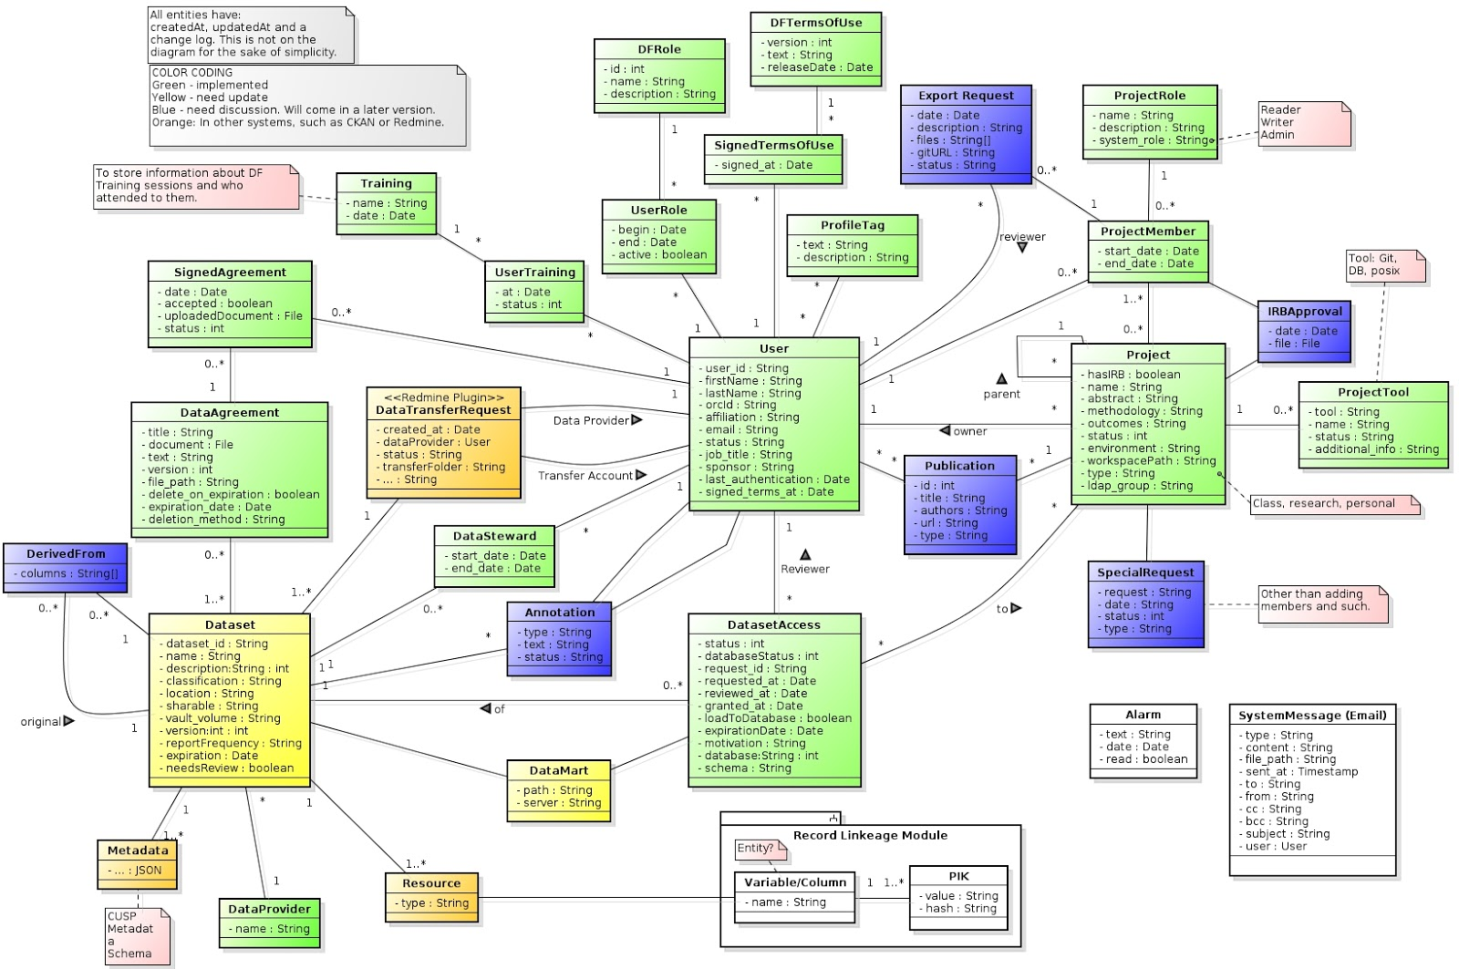
Data Model

Slide 11
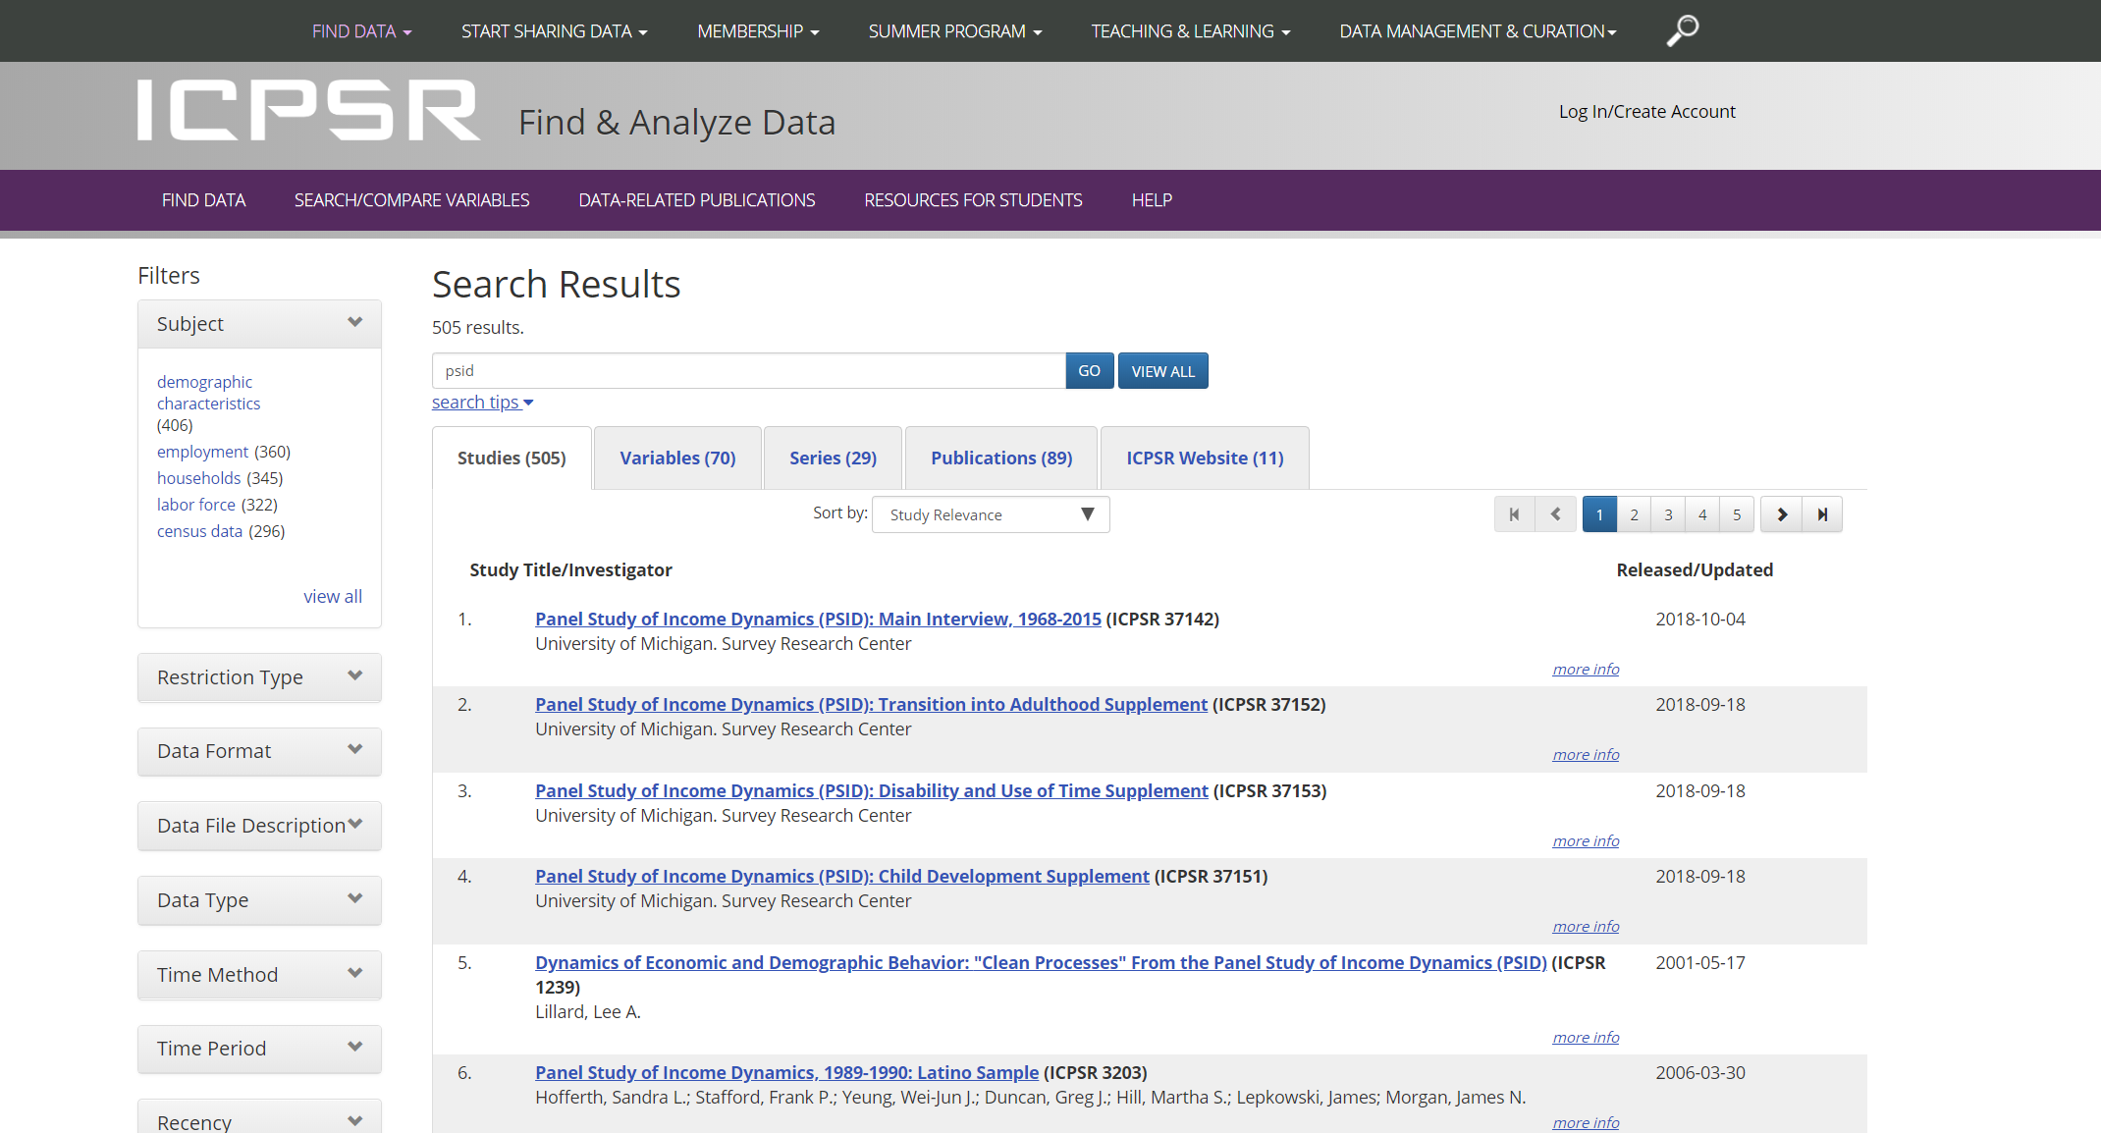
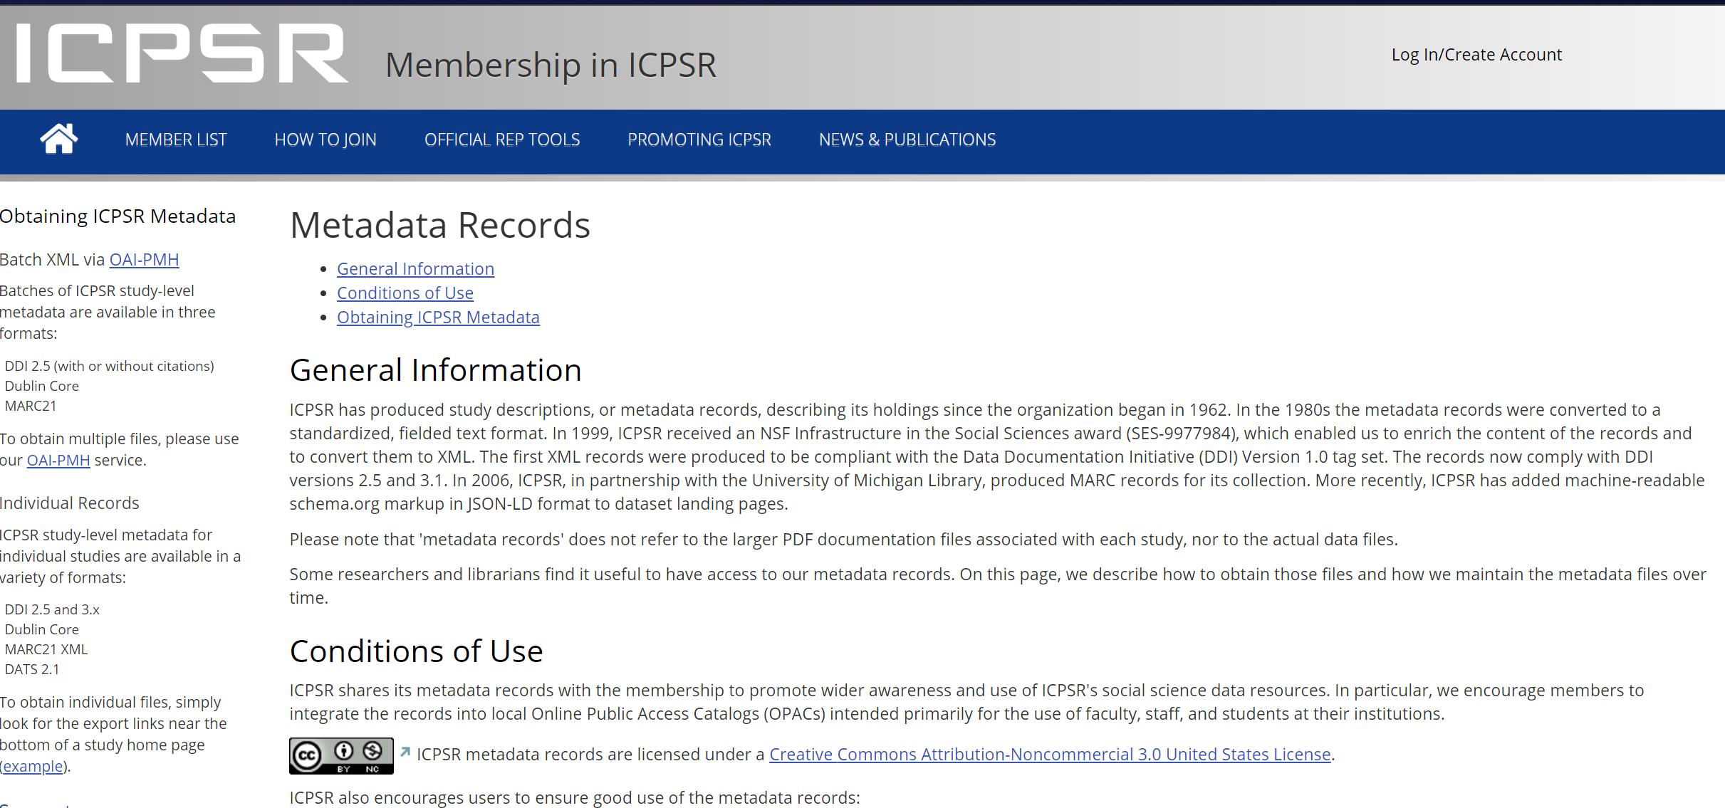
Identify tagged corpus

Slide 12
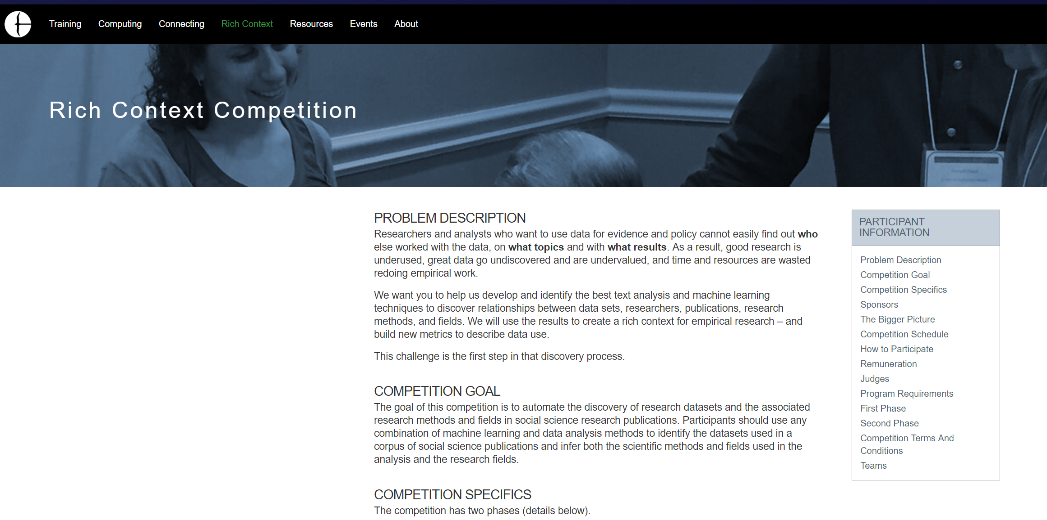
Run competition (https://coleridgeinitiative.org/richcontextcompetition)

Slide 13
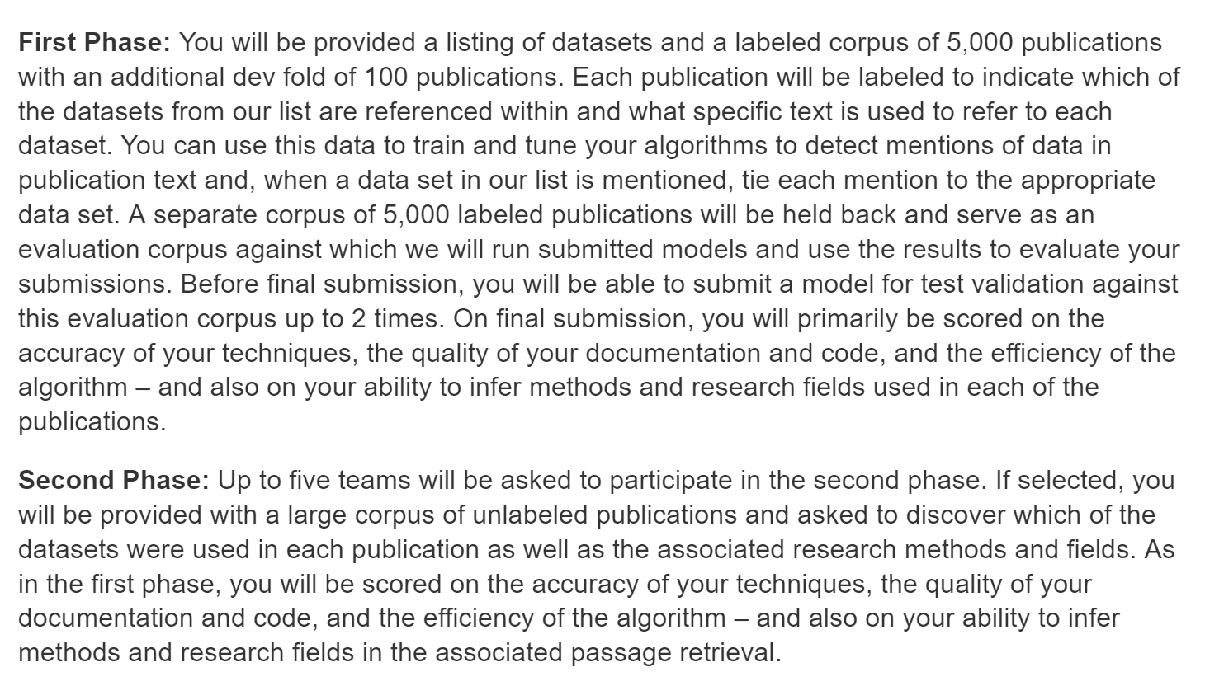
Two Phases

Slide 14
Next steps 1
Work with Dimensions/Digital Science
https://coleridge.dimensions.ai/discover/publication
Apply model to 60 million documents
Develop user facing tools with Dimensions, Figshare, Altmetric, Readcube Papers and Symplectic Elements.
Human curation and validation of algorithm

Slide 15
Next steps 2
Work with Sage Publications
Identify one or two SAGE journals where we could run any new papers from those journals against the model and recruit the authors to help verify the models
Develop data impact metrics/dashboards for journals or authors

Slide 16
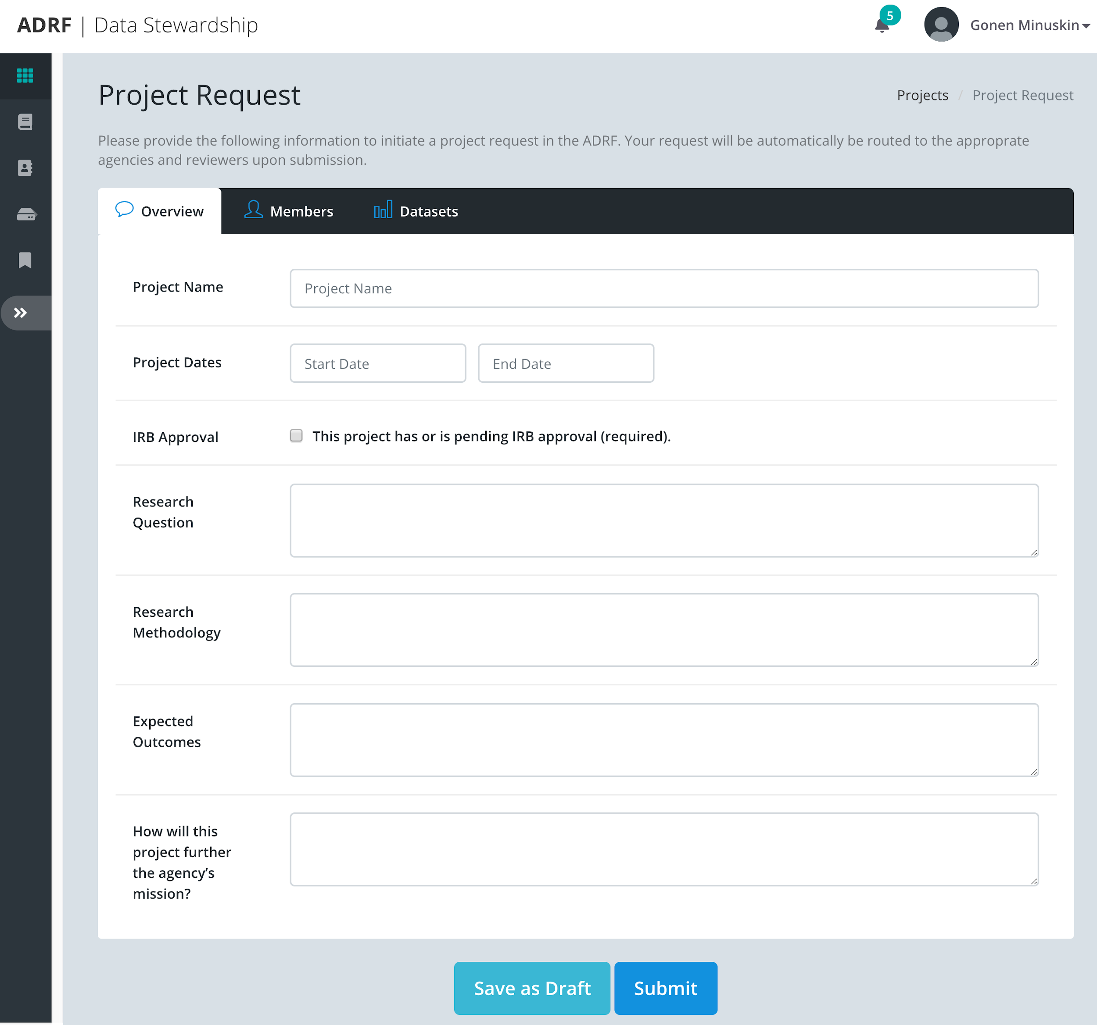
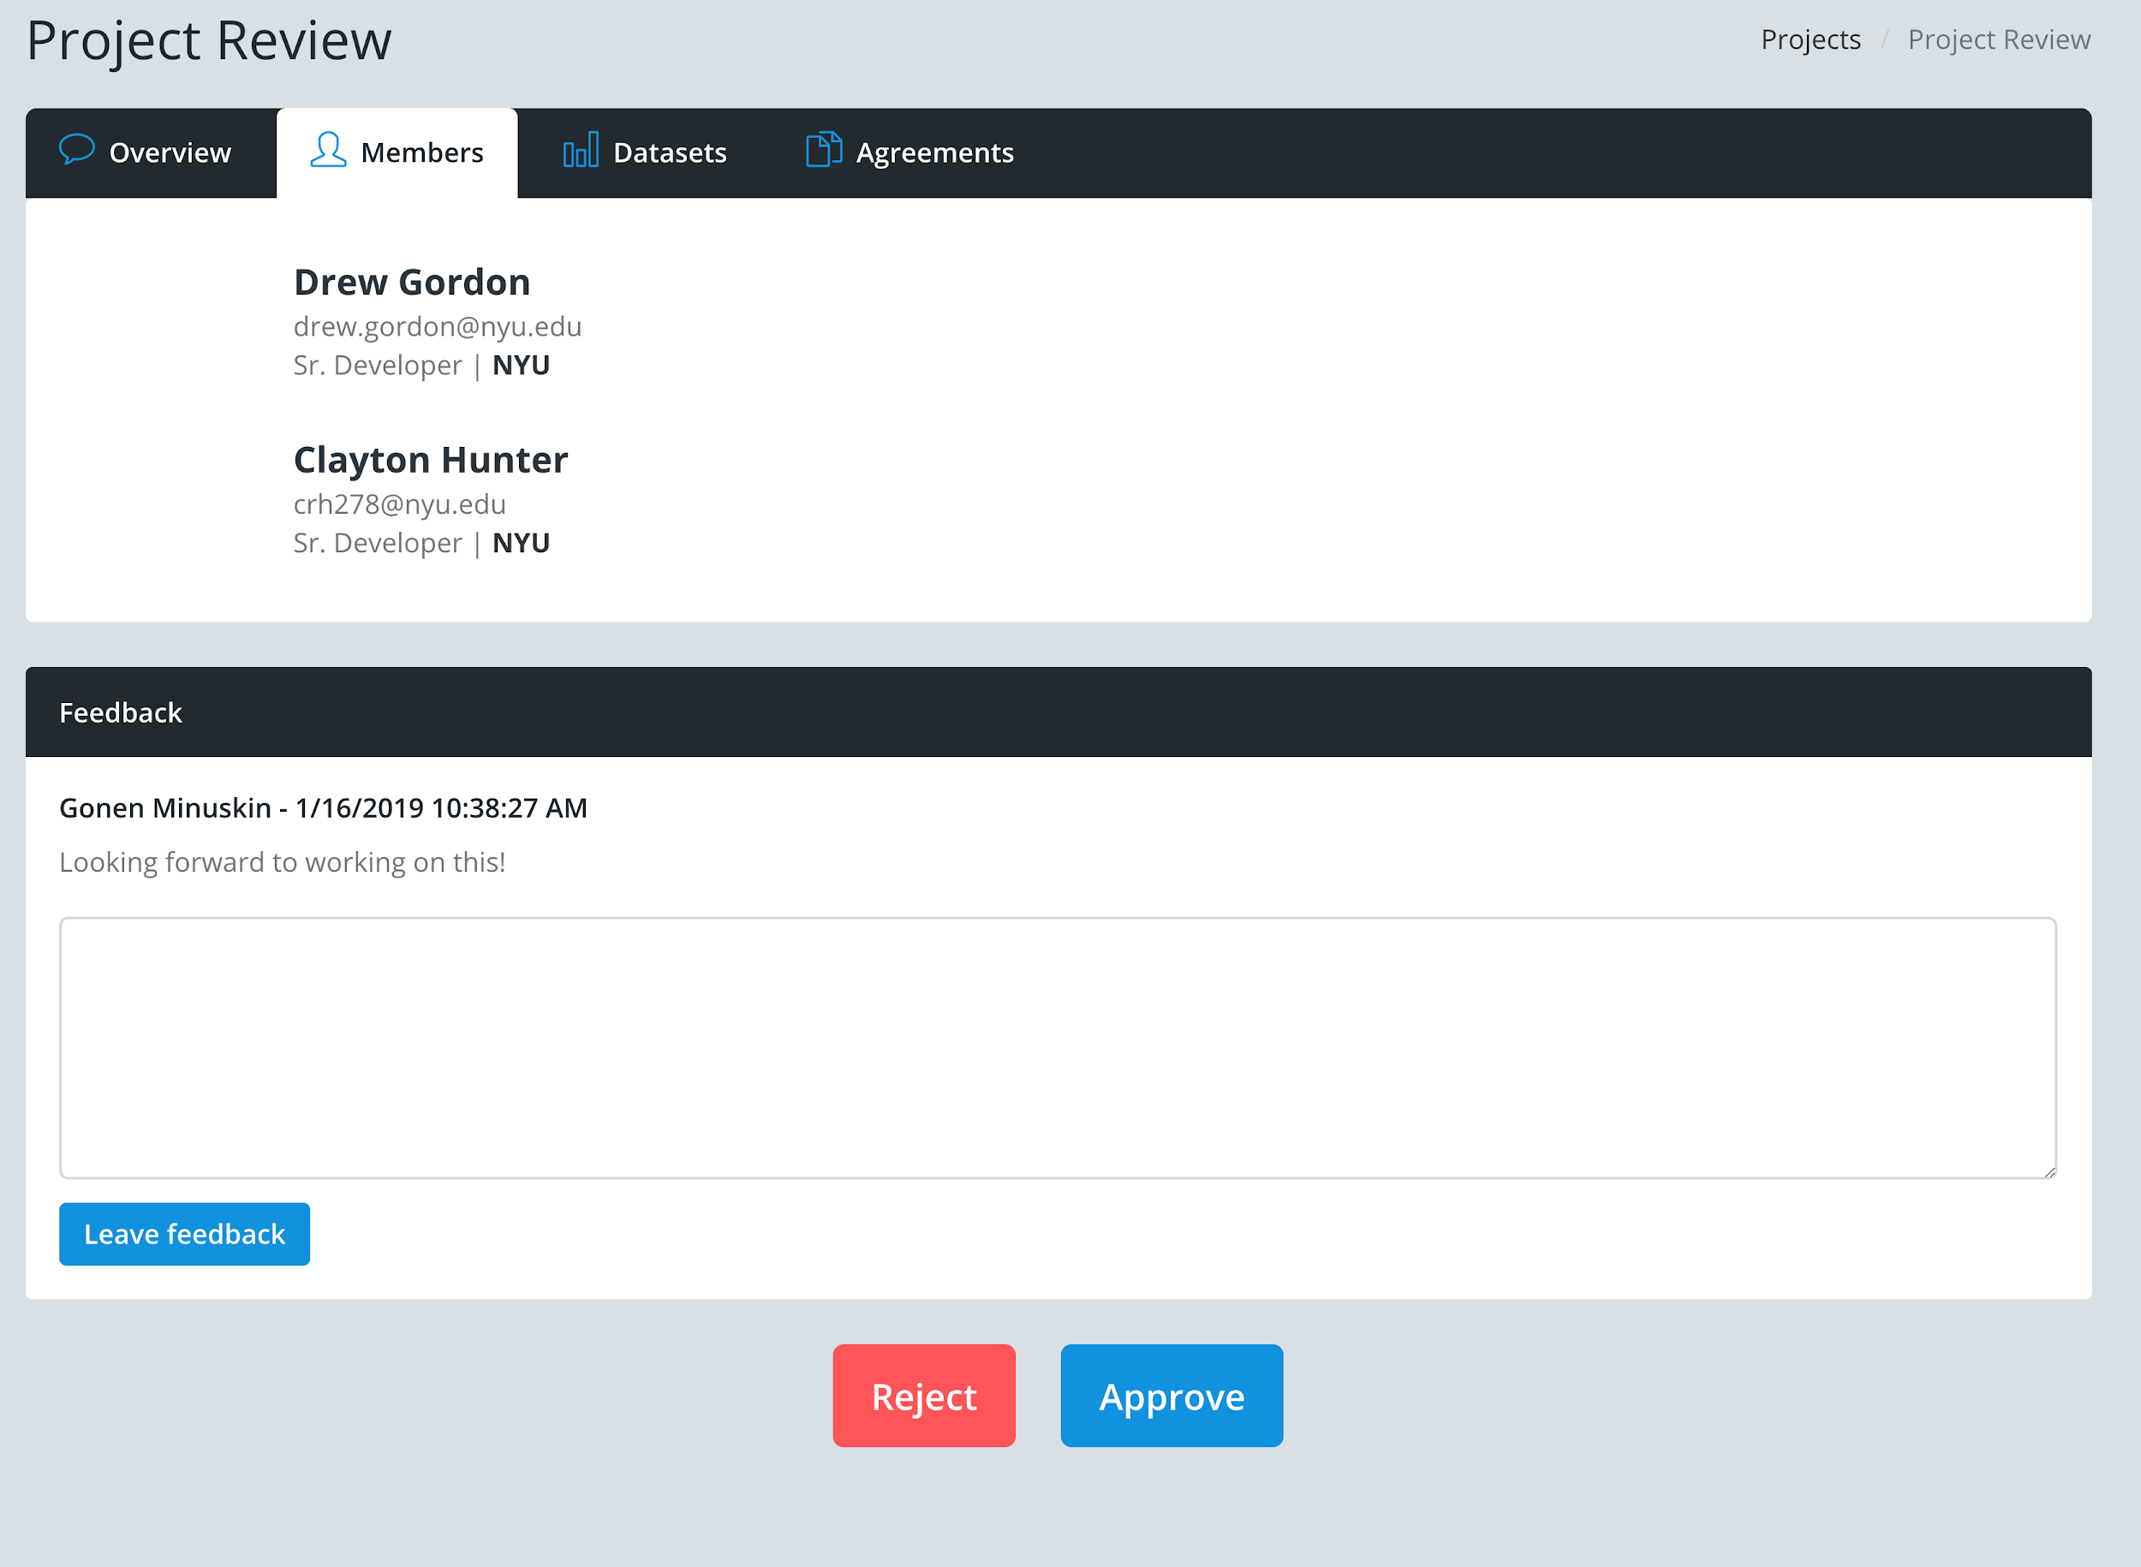
Next Steps 3: Build into Researcher Onboarding
Members

Slide 17
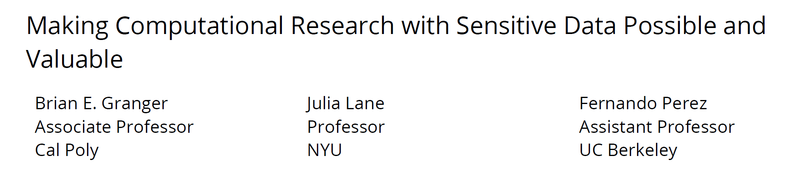



Next Steps 4: Jupyter Notebook

Slide 18
Rinse and Repeat (https://coleridgeinitiative.org/richcontextcompetition)

Slide 19
Book
Will be published by Sage Press
Tentative title “Where’s Waldo: Searching for Data in Empirical Research”
Structure
Editors’ Overview
Conceptual Framework
Approach
Participant chapters
Future agenda
Timeline:
First draft: March 15
Referee reports: May 15
Revisions: July 15
Final decision: August 15
Subsequent publication online and in hard copy

Slide 20
Agenda

